Slide 1
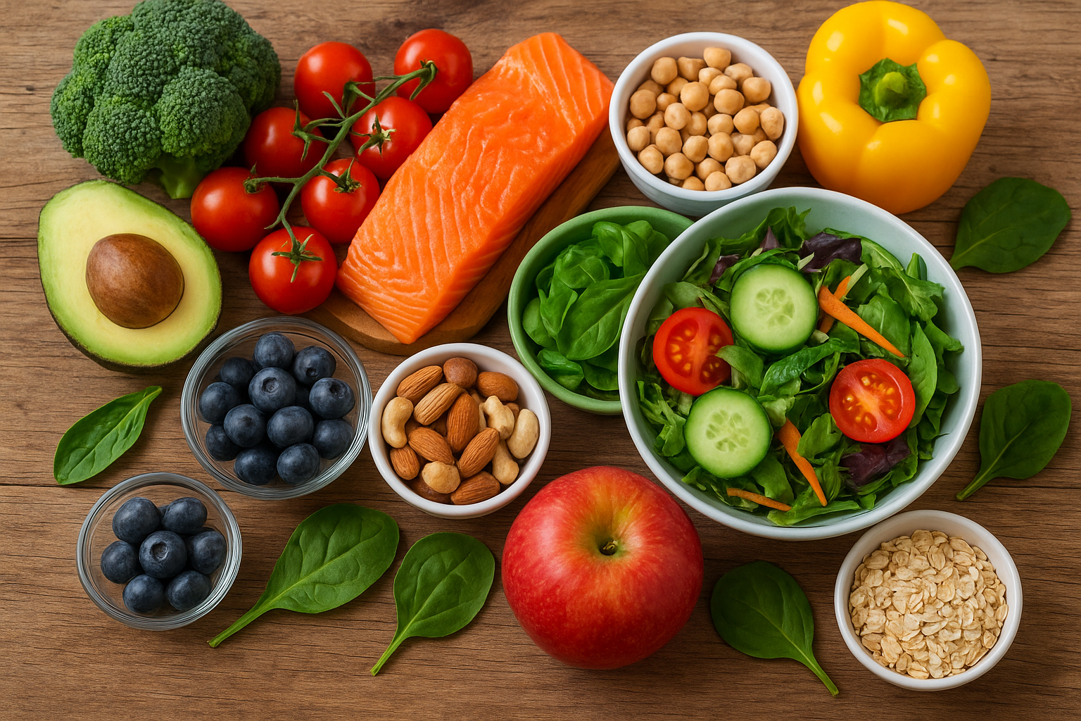
Food Trends Understanding Customer Preferences in F&B
Presented By : Kshitija Kalyan Karpe

Slide 2
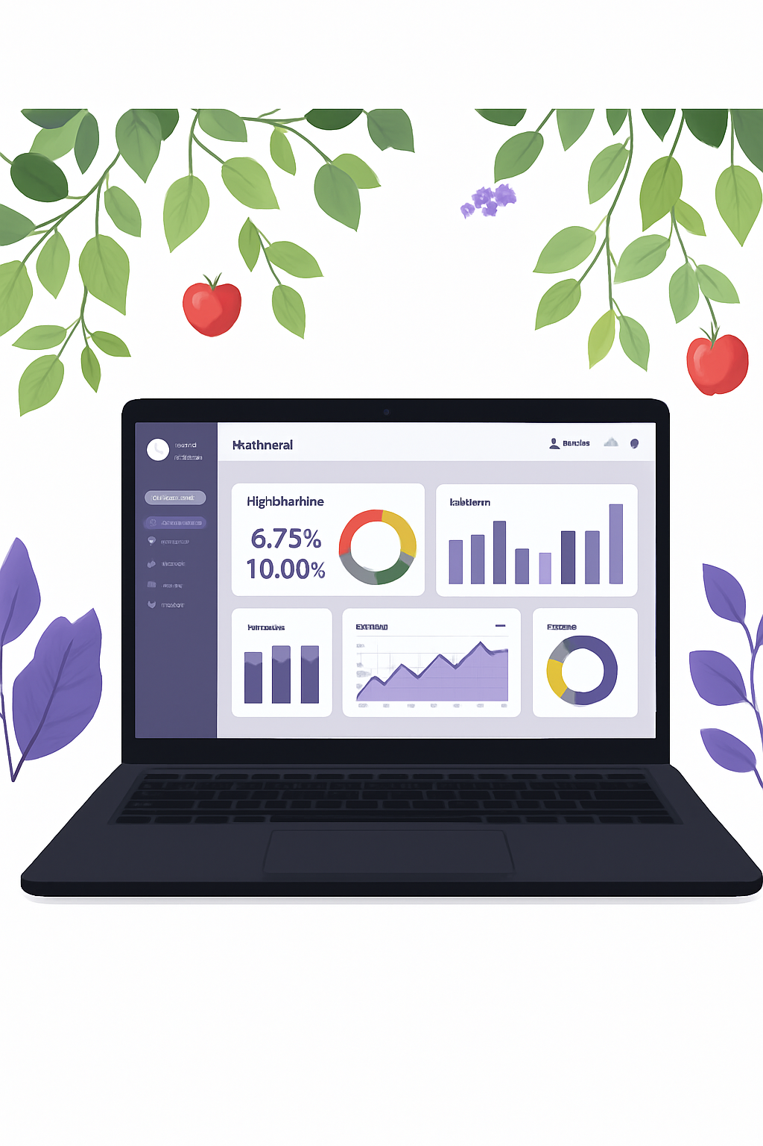
Project Objective
What We Analyzed
Our Impact
Consumer food habits, nutritional patterns, and dietary behaviors were examined through advanced data analytics and Power BI visualization. The study explored how demographic and lifestyle factors—including age, gender, body composition, activity level, and dietary preferences—shape food selections and nutritional intake across different meal types.
We uncovered critical relationships between key nutritional components (protein, fat, fiber, sugar, sodium, and calories) and meal preferences throughout the day. Interactive dashboards now empower food brands and health organizations with insights on pricing trends, customer satisfaction, and disease correlations.
This project bridges the gap between consumer preferences and healthy eating, enabling data-driven recommendations that promote balanced diets and better decision-making for individuals and organizations alike.

Slide 3


Technology Stack and Tools Used
Microsoft Excel
Power Query
Primary data source storing demographic and nutritional data in structured .xlsx format
Data cleaning engine for removing duplicates, fixing missing values, and standardizing formats
Power BI Desktop
DAX Expressions
Core platform for data modeling, visualization, and creating interactive dashboards with KPIs
Advanced analytics language for calculated fields, custom measures, and analytical KPIs

Slide 4
Project Execution Phases
01
02
03
Data Collection & Import
Data Cleaning & Transformation
Data Modeling & Relationships
Gathered comprehensive dataset containing demographic, dietary, and nutritional details. Imported into Power BI and verified column consistency and data integrity.
Leveraged Power Query Editor to remove duplicates, handle blanks, and engineer derived columns including BMI and Calorie-to-Protein Ratio for deeper analysis.
Established robust one-to-many relationships between tables and applied sophisticated DAX measures for calculating averages, ratios, and custom metrics.
04
05
Dashboard Design & Visualization
Testing & Documentation
Created seven comprehensive dashboards featuring charts, slicers, KPIs, and interactive filters with consistent theme and professional layout design.
Verified all DAX calculations, ensured responsive visual performance across devices, and prepared detailed final report with insights and visual documentation.

Slide 5
Dashboard Overview
Seven Powerful Dashboards for Comprehensive Food Intelligence
1
Demographic Insights
Analyzes customer segmentation by age, gender, and diet type to identify and understand target consumer groups
2
Dietary Preferences & Averages
Displays detailed nutrient averages and disease prevalence counts based on diet type and gender demographics
3
Nutrients & Diseases
Explores critical links between nutrient intake patterns and health conditions using decomposition tree visualizations
4
Breakfast Suggestions Analysis
Evaluates popular breakfast items with comprehensive price comparisons, nutrient values, and customer satisfaction ratings
5
Lifestyle & Nutrition Impact
Studies calorie balance, BMI trends, and activity level impact on achieving personal nutrition goals
6
Nutrition & Health Insights
Highlights gender-based calorie distribution patterns, BMI trends, and key health indicators across populations
7
Value & Cost Analysis
Compares food costs against nutrient density and customer ratings to identify cost-effective, nutritious meal options

Slide 6





Challenges Faced and Solutions
Data Source Integration
Challenge: Import errors due to inconsistent data types across source files
Solution: Cleaned and reformatted all data using Power Query preprocessing techniques
Data Quality Issues
Challenge: Duplicates and non-standard values distorted visualization accuracy
Solution: Unified category naming conventions and systematically removed blank entries
Data Modeling Relationships
Challenge: Circular dependency errors disrupted data model integrity
Solution: Rebuilt optimized one-to-many relationships with correct primary and foreign keys
Complex DAX Measures
Challenge: Difficulty creating accurate and efficient KPI calculations
Solution: Simplified formulas using modular DAX design patterns and VAR functions for clarity
Dashboard Performance
Challenge: Slow load times due to excessive visual complexity
Solution: Optimized by consolidating visuals and simplifying DAX query structures

Slide 7
Key Learnings and Skills Acquired
Technical Skills
Soft Skills
Developed proficiency in Power BI Desktop for building analytical dashboards and comprehensive reports
Enhanced analytical thinking, critical reasoning abilities, and meticulous attention to detail
Mastered data cleaning and transformation using Power Query Editor for efficient data preparation
Improved communication and presentation skills through effective data storytelling techniques
Designed and implemented relational data models using Star Schema methodology for optimal analysis
Strengthened teamwork, cross-functional collaboration, and project management capabilities
Advanced expertise in DAX functions for complex KPIs, ratio calculations, and sophisticated trend analysis
Learned effective time management strategies and task prioritization throughout the internship timeline
Understood the critical importance of visual storytelling, strategic chart selection, and user interactivity design
This internship provided a comprehensive foundation in business intelligence, combining technical expertise with professional development for a successful career in data analytics.

Slide 8
Conclusion and Impact
Project Achievements
Key Discoveries
Industry Impact
Successfully transformed raw demographic and nutritional data into actionable business insights through sophisticated Power BI dashboards and advanced analytics techniques
Revealed how diet choices, lifestyle patterns, activity levels, and pricing strategies collectively influence customer satisfaction and nutritional balance across diverse populations
Enabled data-driven decision-making in the Food & Beverage sector, promoting accessible healthy food trends and affordable nutrition options for consumers
Technological Innovation
Used Power BI to convert complex food and nutrition data into clear, actionable insights showcasing how analytics and visualization drive smarter business decisions in the F&B sector.
Health & Sustainability
Encouraged balanced and sustainable eating habits by identifying nutrient-rich, affordable, and health-conscious food trends that align with modern lifestyles.
Learning & Growth
Strengthened technical, analytical, and teamwork skills through hands-on experience in Power BI, data modeling, visualization, and insight storytelling.

